Slide 1
Convolutional Neural Networks

Slide 2
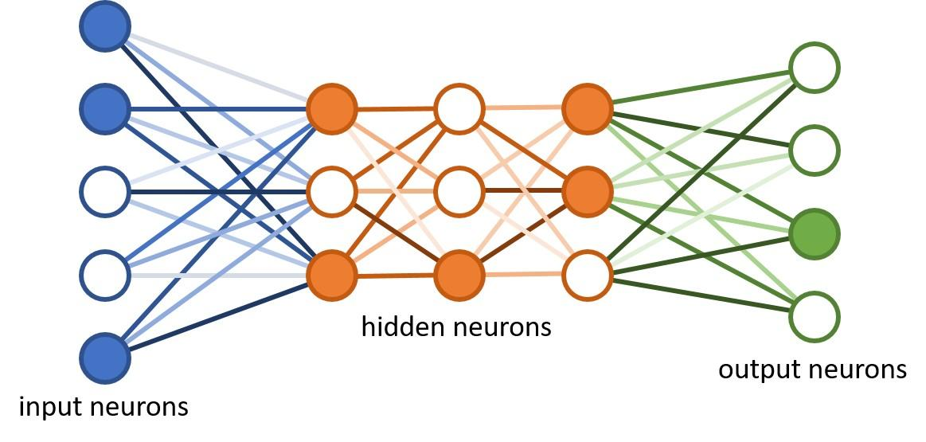
CNN’s are just types of neural networks typically applied to analyzing visual imagery

Slide 3
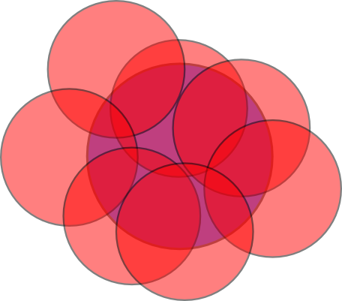
Inspired by the biology of the visual cortex
Each neuron in our eye covers a different area of our visual field

Slide 4
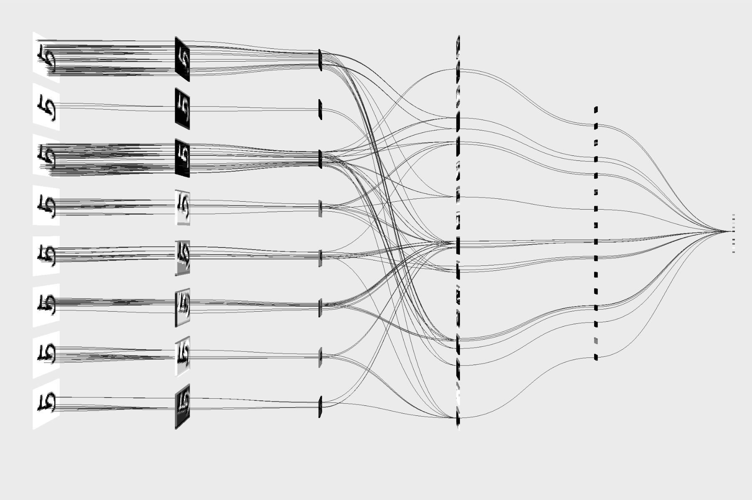
Abstract architecture of a Convolutional Neural Network

Slide 5
How do they Work?
?
The Basics

Slide 6
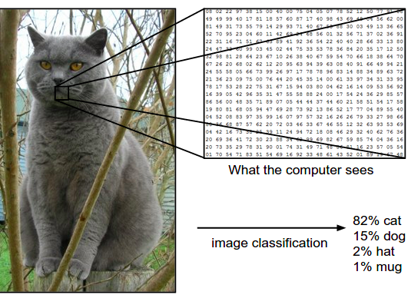
Step 1
Process the Image

Slide 7
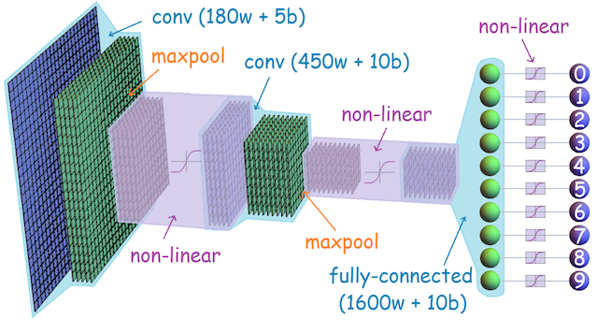
Step 2
Use matrices to
move the image
through
the network

Slide 8
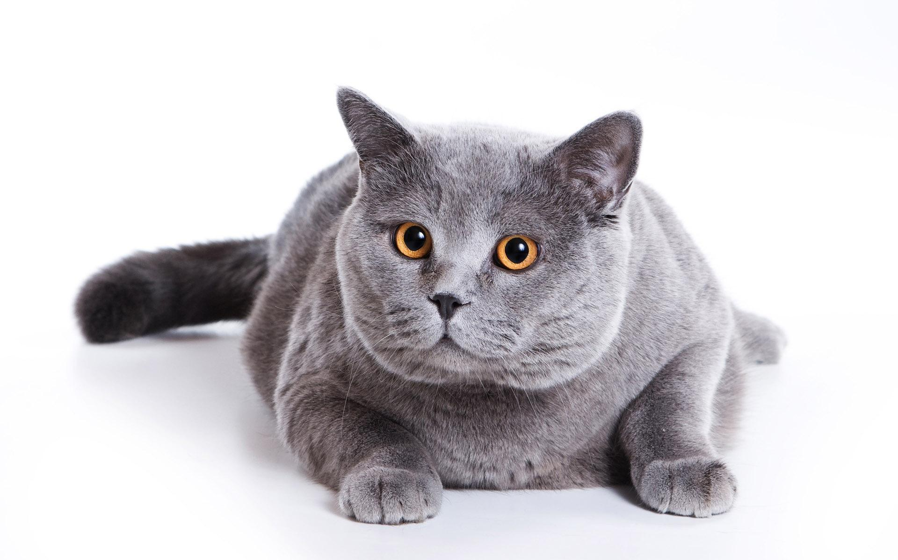

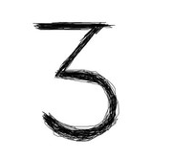
Step 3
Tell the network “what’s what”...
Cat
Plane
Three
Cat
Plane
Three
Cat
Plane
Three

Slide 9
With that, all kinds of problems can be solved
Medical Image Analysis
Face Detection
Image Recognition
Natural Language Processing

Slide 10
But, they’re not perfect
The Problems

Slide 11
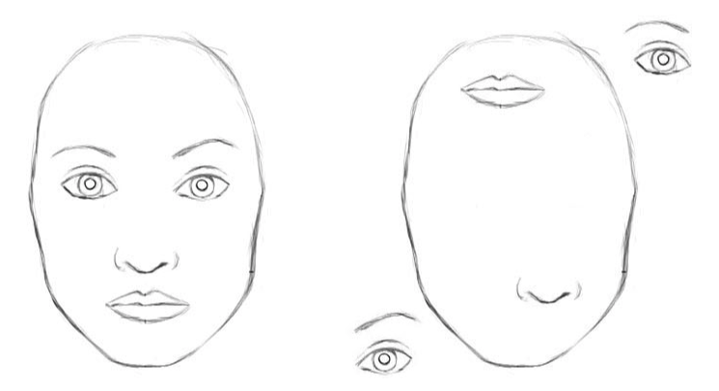
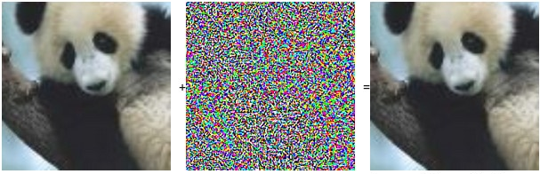
Tiny Changes, Big Mistakes
Panda
Gibbon?

Slide 12
Credits
https://machinelearningmastery.com/when-to-use-mlp-cnn-and-rnn-neural-networks/
https://medium.freecodecamp.org/an-intuitive-guide-to-convolutional-neural-networks-260c2de0a050
https://www.quora.com/What-are-the-current-problems-with-the-use-of-convolutional-neural-networks-CNN-for-vision
https://en.wikipedia.org/wiki/Convolutional_neural_network

